Slide 1

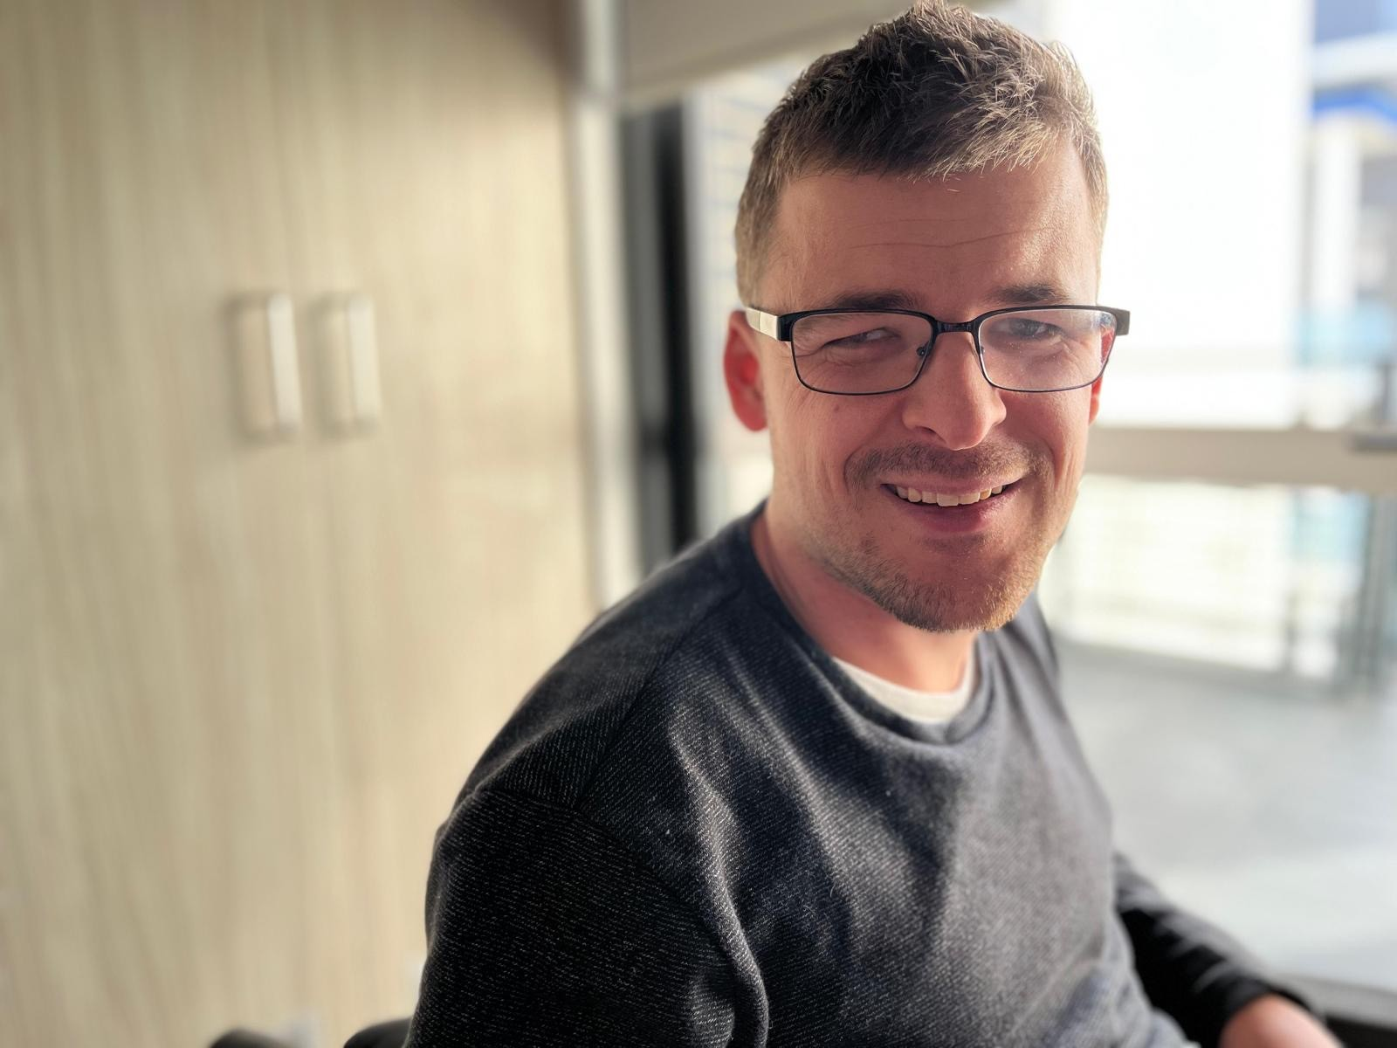
Employment
Scott Taylor
Project Officer - Social and Cultural Development team
City of Ryde

Slide 2
My Mainstream Employment Journey
Leaving school/difficulty in finding employment
Working in the family business
Moving to Sydney for dream job, then move into the disability space
Working for City of Ryde, what I do and “Empower Ryde”
Learnings from my journey and key takeaway message

Slide 3
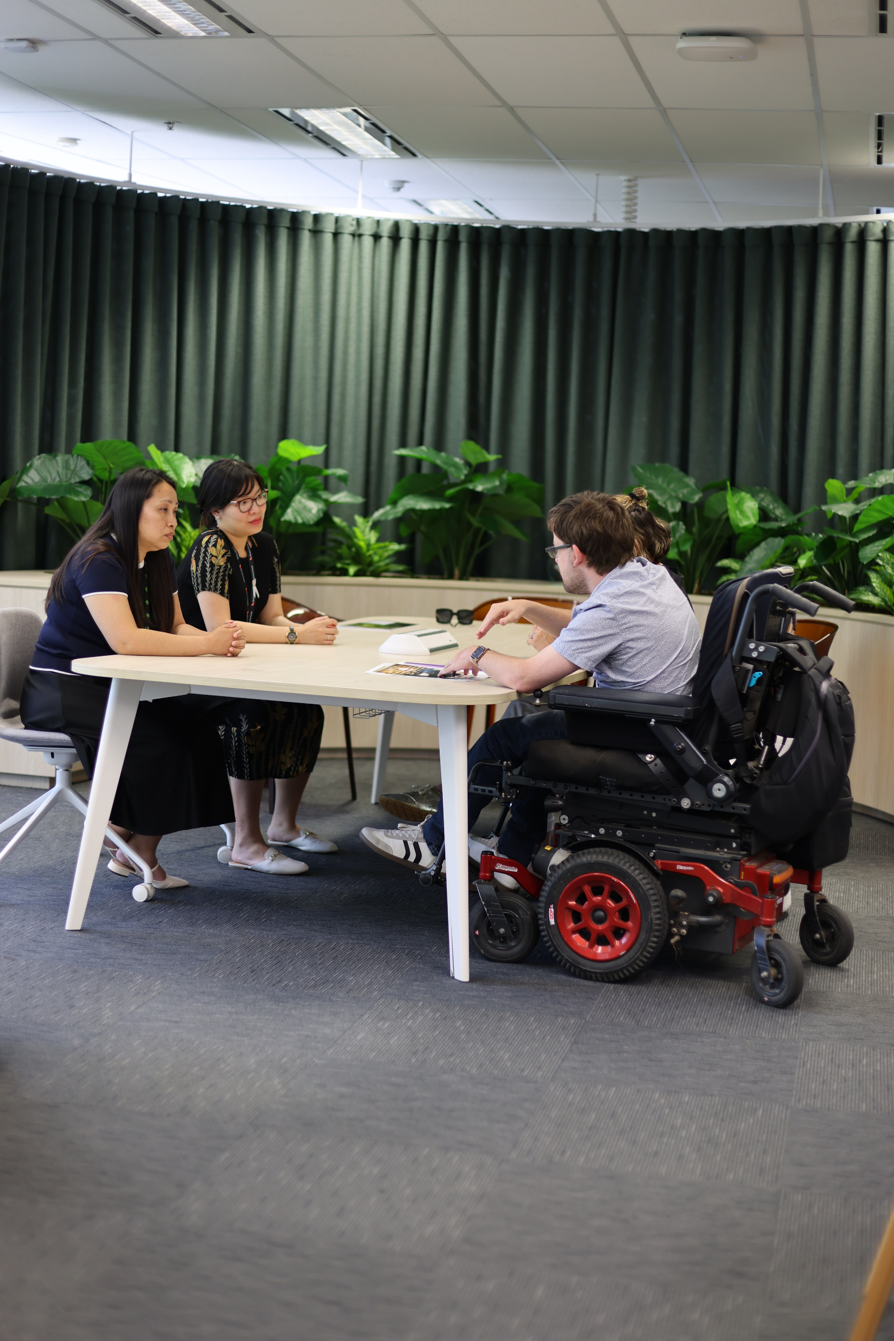
Empower Ryde Background
 | Key objectives
Disability Inclusion Action Plan 2022-2026 | Promoting positive attitudes and behaviours. Improving our community as an easy place to live and get around. Facilitating access to volunteering and work opportunities, including within Council. Providing easy to understand information and accessible and inclusive services.
Economic Development Strategy (2024) | Encouraging more businesses to employ people with disability. Increasing support for businesses that are owned and operated by people with disability.

Slide 4
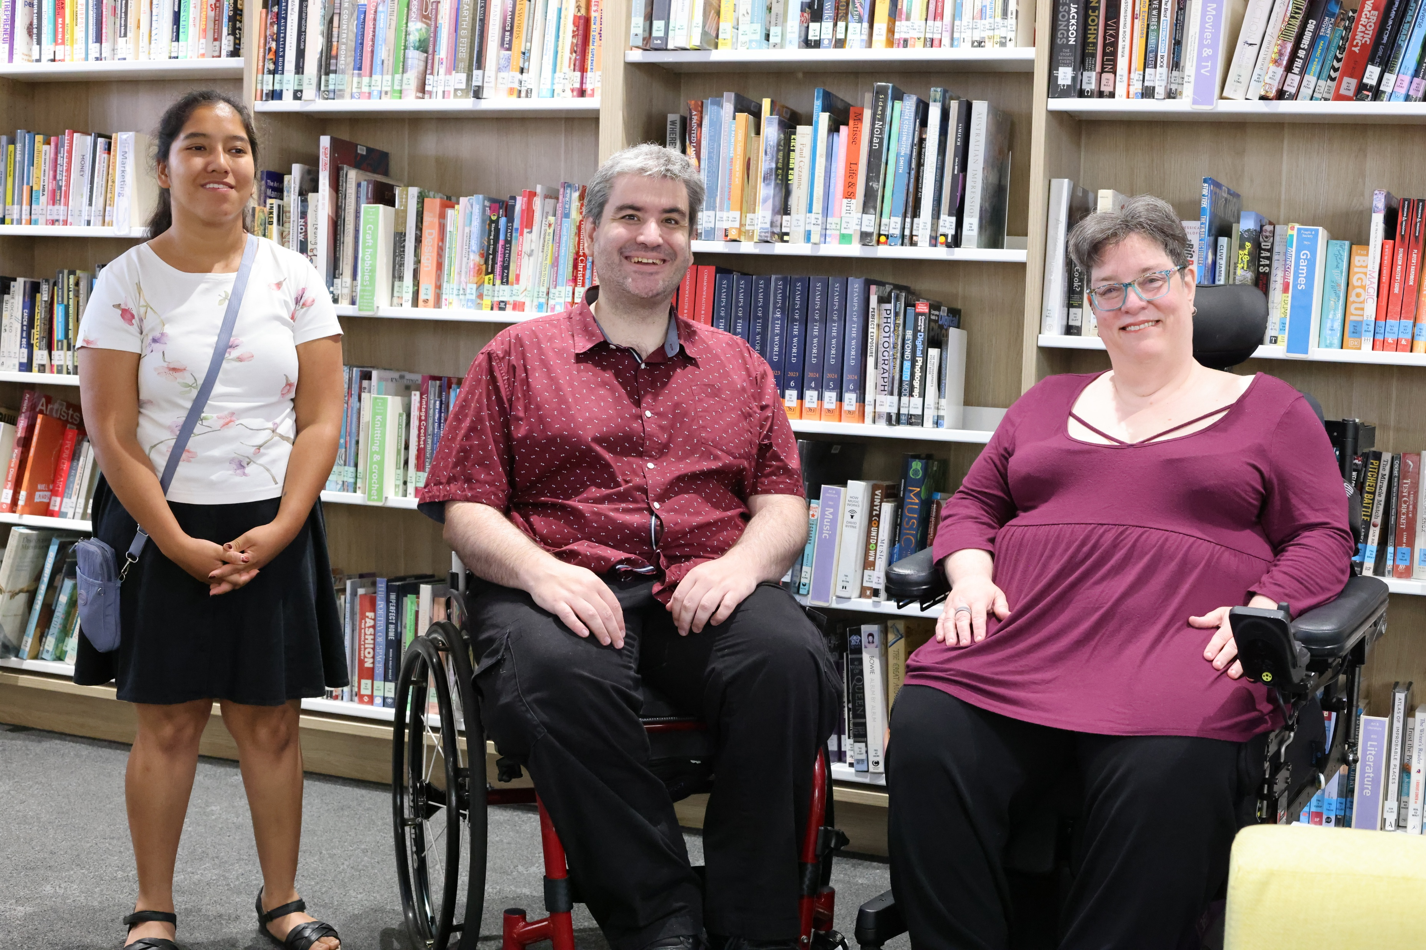
About Empower Ryde
Peer-led employment and skills program delivered by the City of Ryde.
Guided by people who understand the lived experience of disability.
Aims to help people build confidence, meet new people, develop job-ready skills, and share key support services and programs.

Slide 5
Empower Ryde Outcomes
Since participating in Empower Ryde, participants have:
Feedback from participants:
Engaged with resources to apply for jobs and sought advice about being a sole trader.
Progressed to interview stages during their job search.
“Empower Ryde helped me understand how things work here and feel connected to my new community”
Obtained part-time paid employment during the program period.
Engaged with the City of Ryde’s Inclusive Volunteering Program
“Being part of Empower Ryde has given me a deep sense of belonging and confidence”

