Slide 1



Preventing everyday harm and improving community attitudes

Slide 2
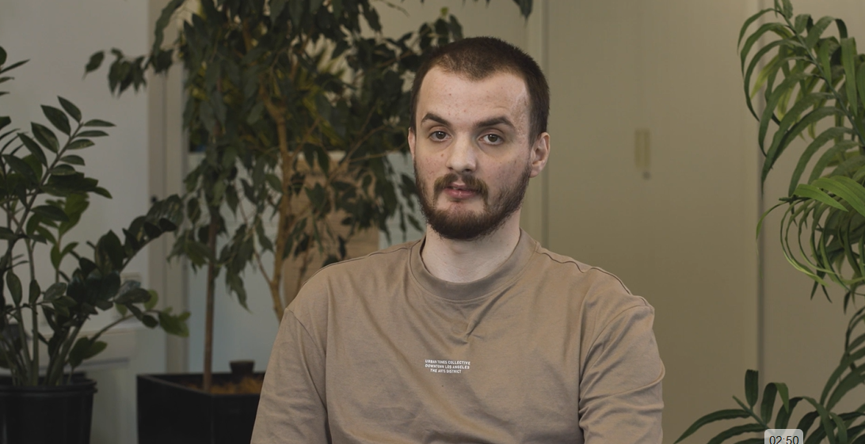
What is everyday harm?
Notes:
VIDEO - CAPTIONS ON
https://everydayharm.org.au/
https://vimeo.com/1143735120/4037b71d36?share=copy&fl=sv&fe=ci

Slide 3

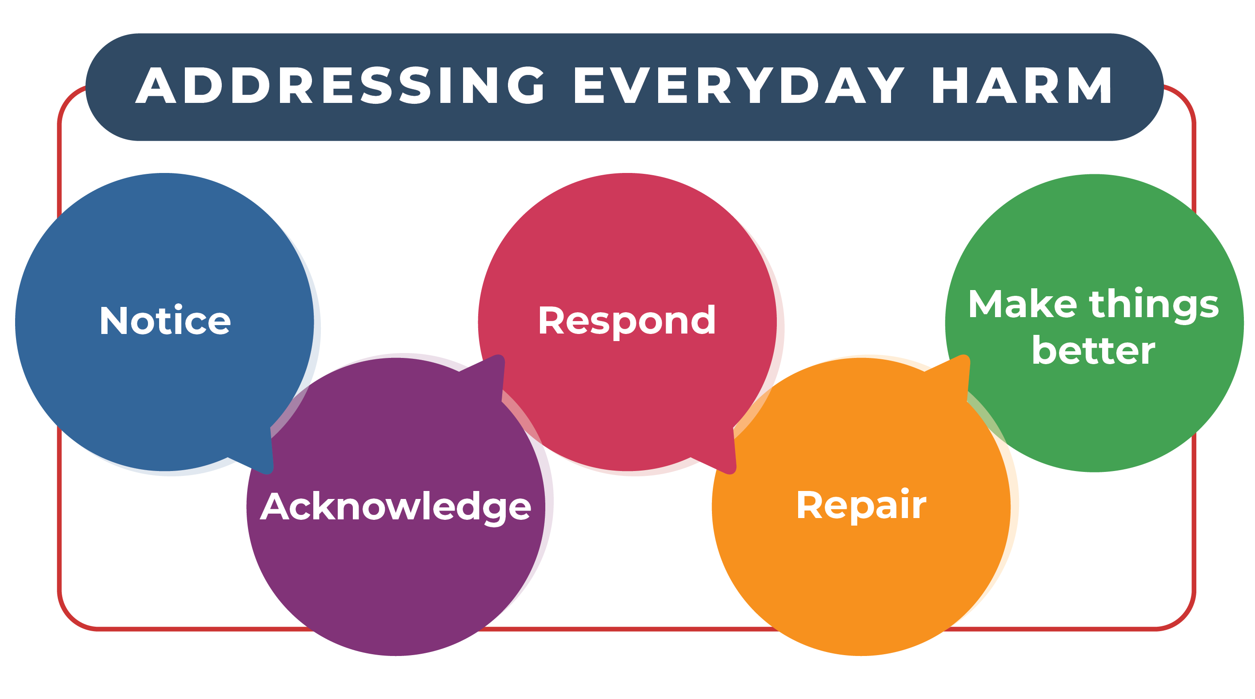
Everyday steps to address and repair everyday harm

Slide 4
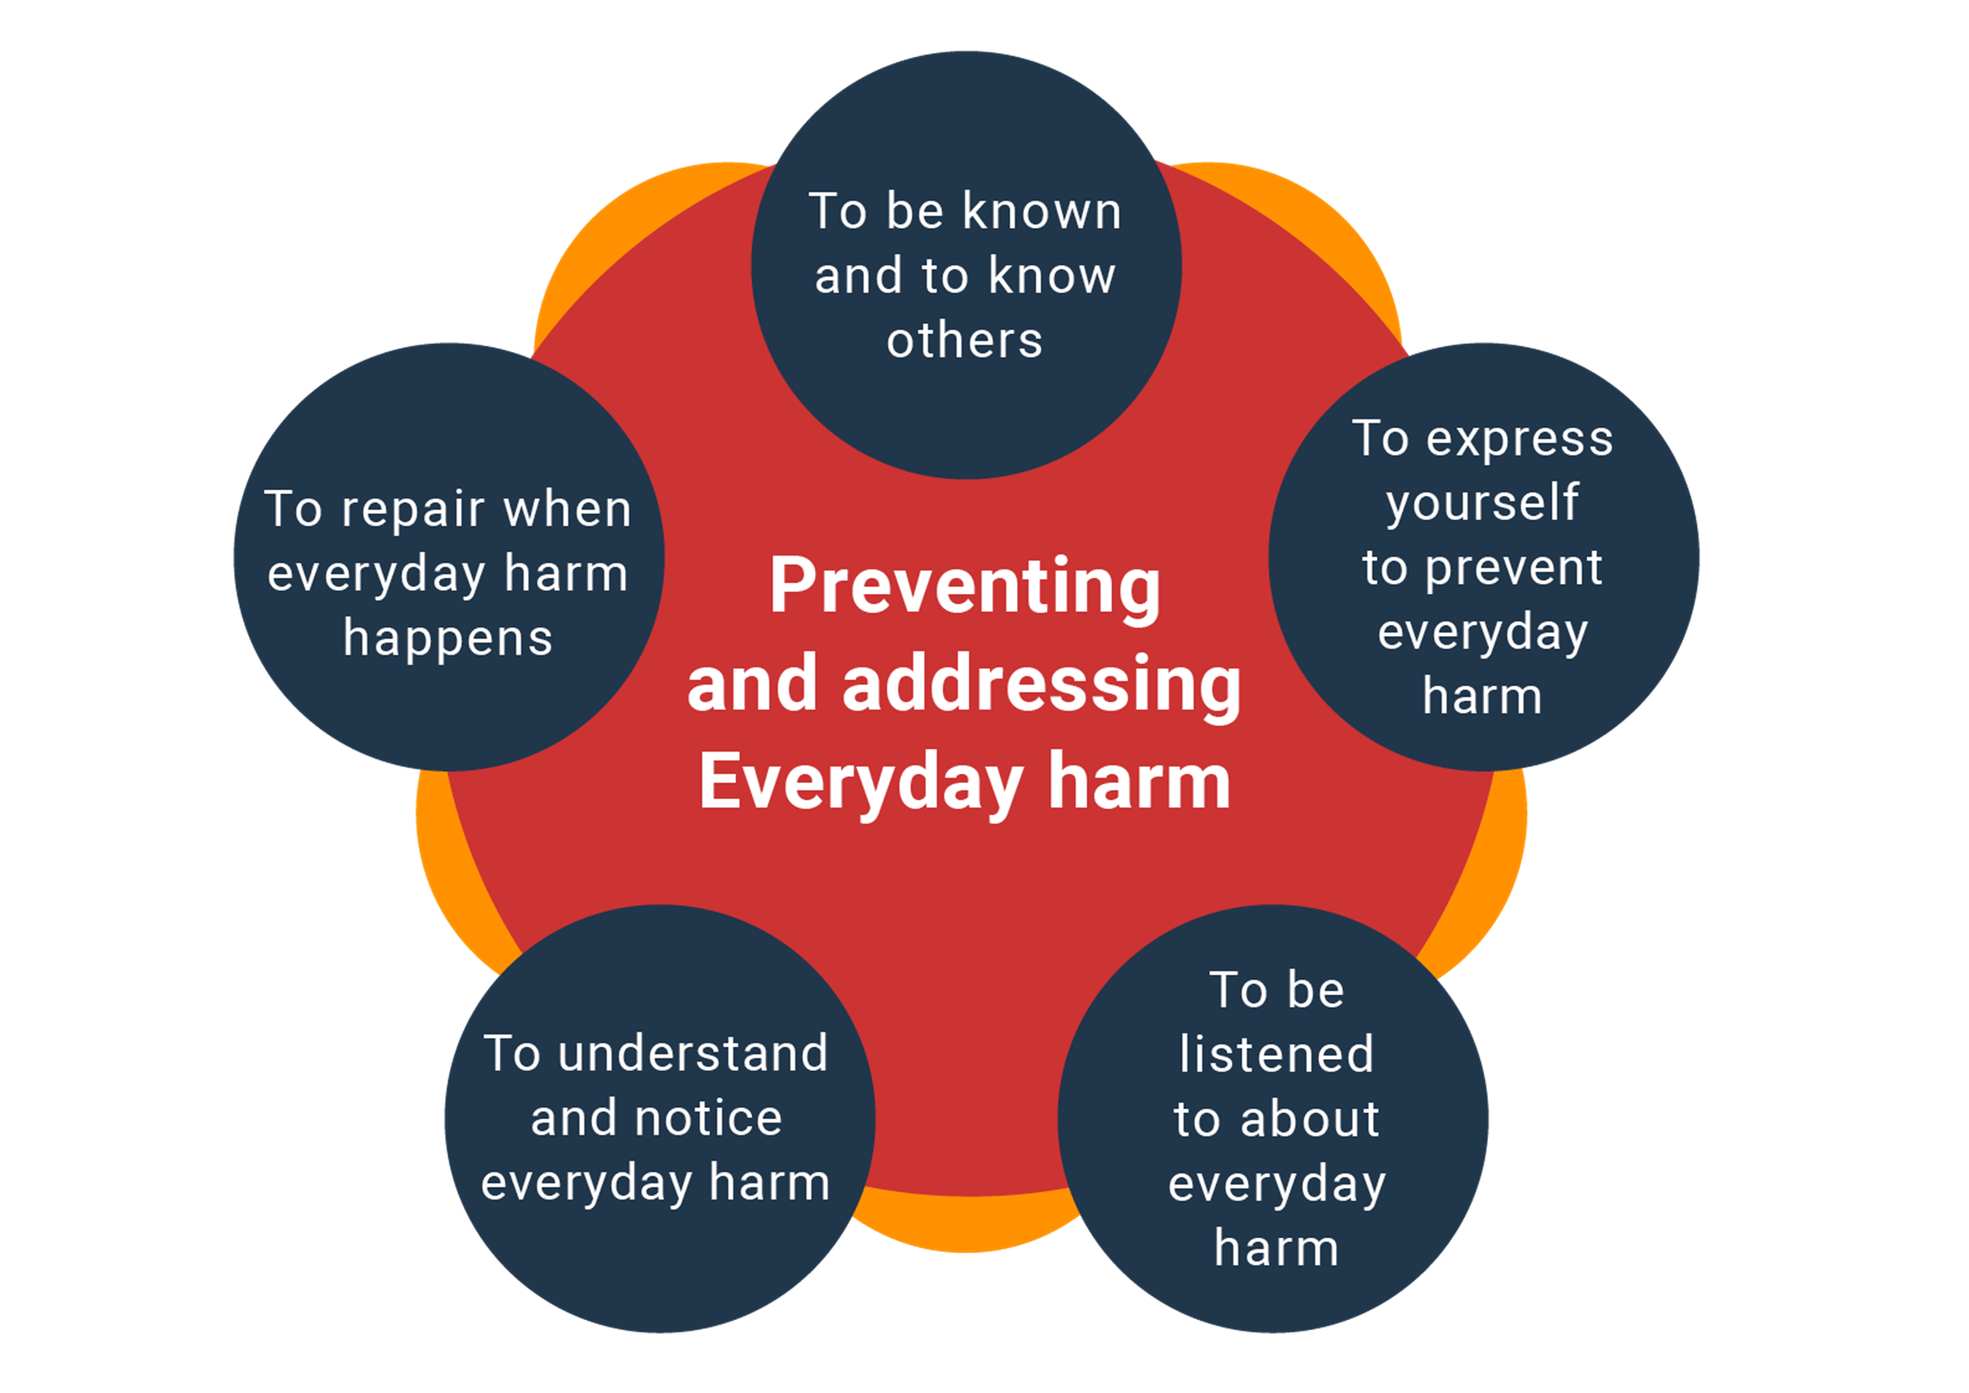
Five rights in preventing and addressing everyday harm
Notes:
As well as steps that you can take in your everyday work, there are key things that you can do that prevent everyday harm from happening, and set up the conditions so that you can use the steps well when it does happen.
What do these five rights make you consider for the way you work together?
1. be known and know others
2. express yourself to prevent everyday harm
3. be listened to about everyday harm
4. understand and notice everyday harm
5. repair when everyday harm happens

Slide 5
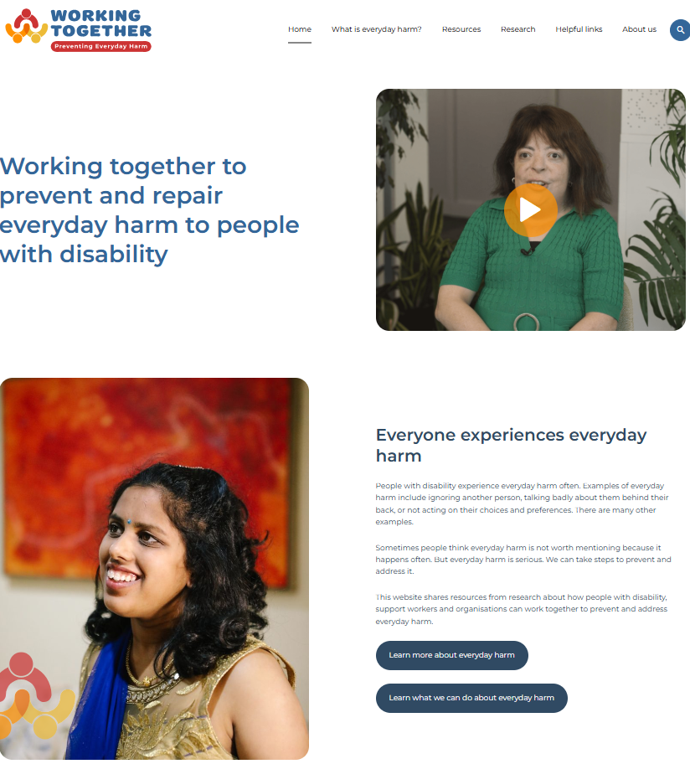

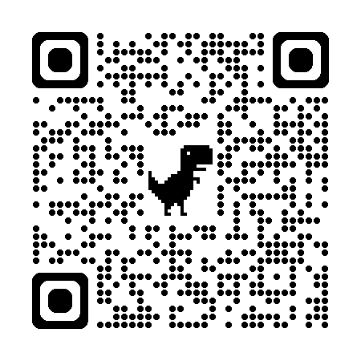
What is on the website?
Ways to learn about everyday harm and what you can do about it
www.everydayharm.org.au

Slide 6

Learning from everyday harm to improve community attitudes to people with disability
How can encounters in public places:
Reduce everyday harm?
Create positive experiences between people?
Help shift community attitudes over time?
Image: Freepik
Notes:
We want to use the EH research next to improve the everyday interactions that people with cognitive disability have with others in the community.
These are things like talking to a shop worker, waiting at a bus stop, or ordering a coffee.
The way these everyday moments happen can change how people think and act.
Why everyday encounters matter
They happen naturally as people go about their lives.
They can help people with cognitive disability be seen and respected.
They show that people with disability have important knowledge and experiences.
They can build trust, respect, and inclusion.
Encounters can be short or long, spoken or unspoken.
They can sometimes go wrong.
But they can also be powerful moments where attitudes change for the better.

Slide 7

Thank you
Thank you to our BIG team
Sally Robinson, Eleanor Watson, Raffaella Cresciani, Su Su Tun, Rachel High, Ruby Nankivell,
Karen Fisher, Anna Jones, Ciara Smyth, Heikki Ikaheimo
Tyra Buteux, Hannah Zsigoszki, Jess Mackie, Sian Martino, Emma Woods
Notes:
Thank you for listening to us, and thank you to our team from Northcott, Flinders University and University of New South Wales.
Does anyone have any questions?

