Slide 1
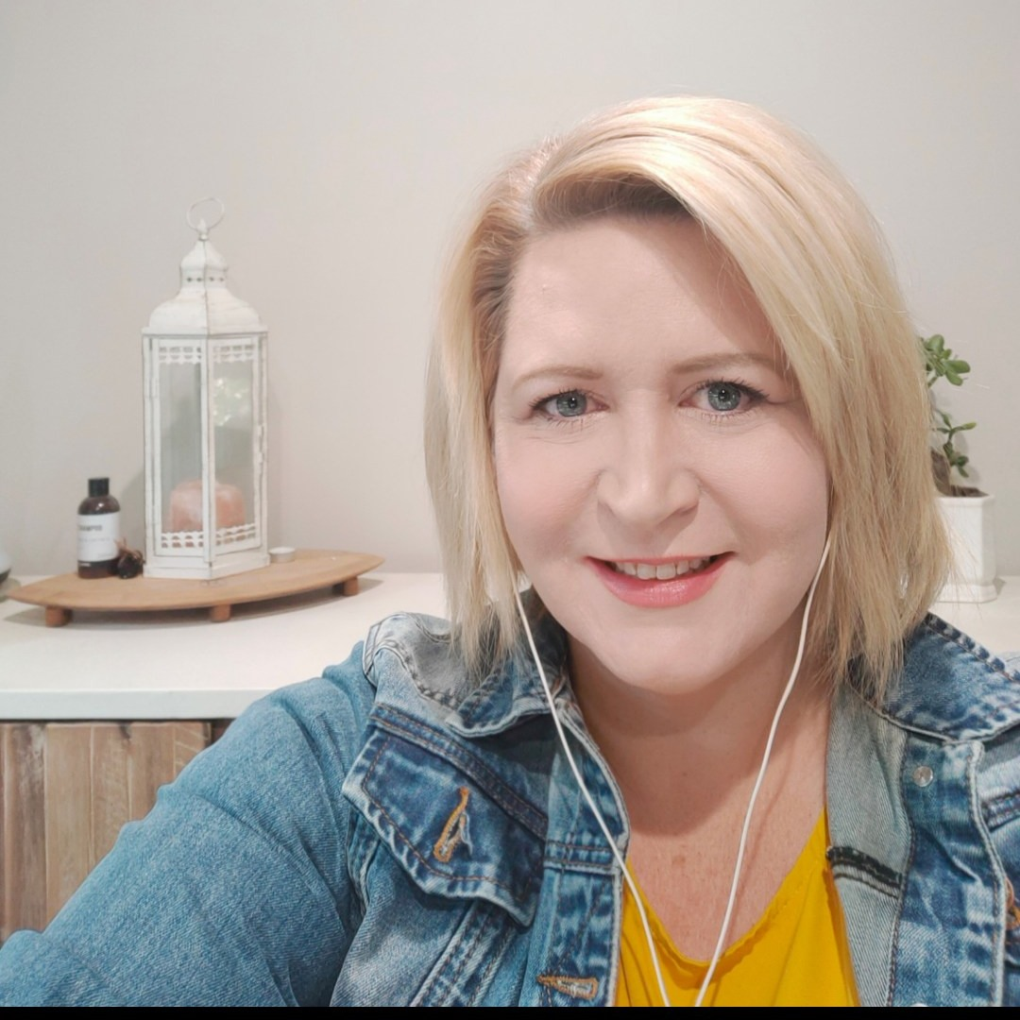
Inclusive Education and Lifelong Learning:
The Local Government Role
Cyndi Neuzerling
Disability Inclusion coordinator
City of Playford
Notes:
Good afternoon everyone and thank you for joining the webinar today. I’d like to begin by acknowledging the Traditional Owners of the lands on which we all meet today and pay my respects to Elders past and present. I also acknowledge the knowledge and lived experience of people with disability who continue to shape more inclusive communities.
We’ve already heard today about the national policy landscape and the research around community attitudes. What I’d like to focus on is where local government fits – and how councils can help translate those big policy ideas into practical opportunities in everyday community life. Local government might not hold responsibility schools, but we run many of the places where learning actually happens in everyday life — libraries, youth programs, community centres and volunteer opportunities.

Slide 2
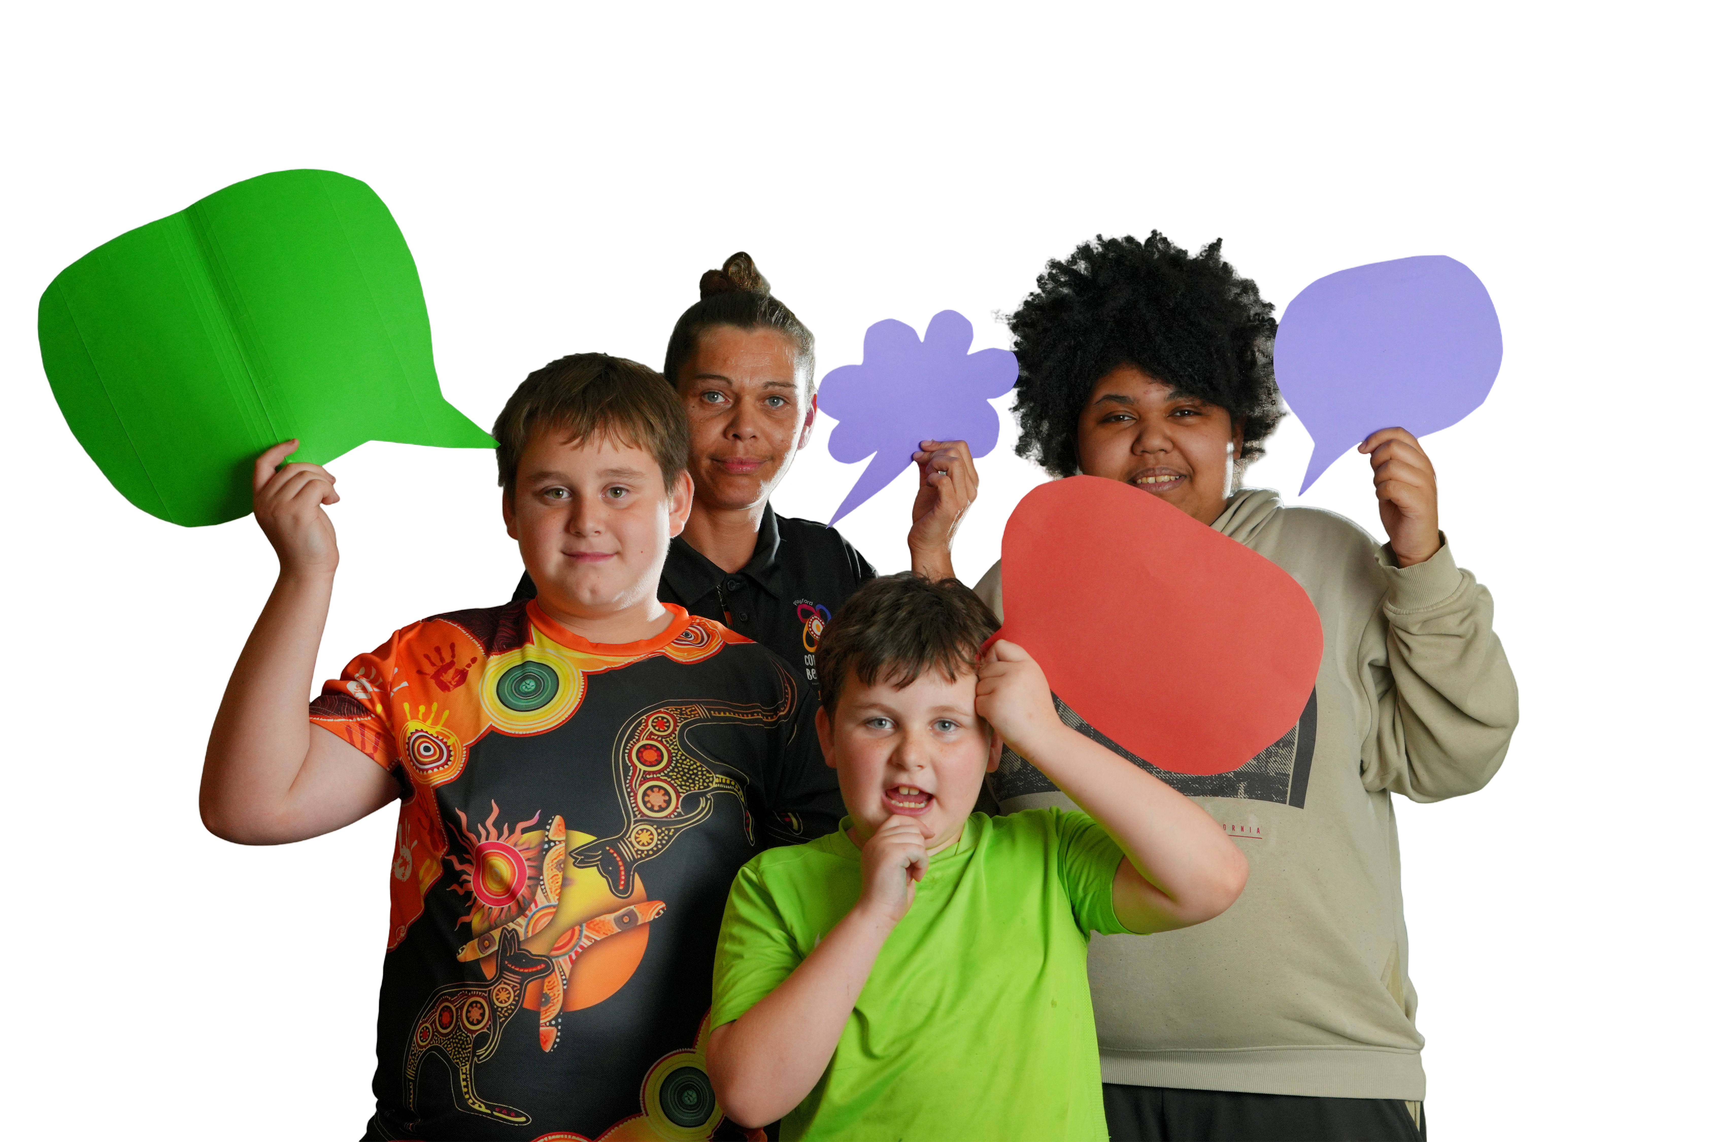
Why This Matters
Notes:
As we heard earlier, disability inclusion is not a niche issue.
More than one in five Australians live with disability – around 5.5 million people.
And that number increases significantly as people age.
Which means disability inclusion is something that touches every community, every council area and every stage of life.
When we talk about education, most people immediately think about schools or universities. But inclusive learning doesn’t just happen in classrooms, it happens in communities. And that’s exactly where local government plays a powerful role.
In reality, education lifts wellbeing and economic security across life, it underpins later employment and health outcomes in the Australia’s Disability Strategy Outcomes Framework. And the local benefits are tangible: when councils normalise inclusive learning in libraries, youth hubs and community centres, we see earlier literacy gains, stronger social participation and more positive community attitudes, the building blocks of an inclusive city.
So I’d like to start by clearing up three common myths.

Slide 3
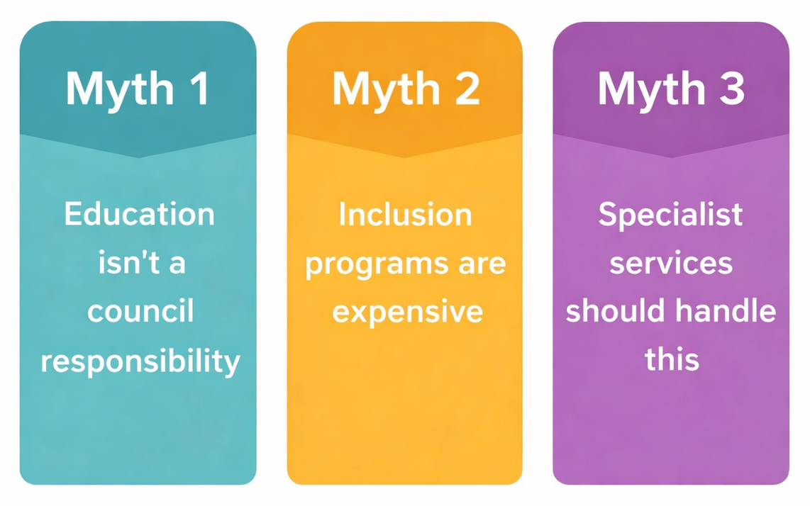
Three Myths about
Education and Councils
Notes:
The first myth is that education isn’t a council responsibility. It’s true formal schooling sits with other levels of government, but learning doesn’t stop at the classroom door. Lifelong learning happens in libraries, community centres, volunteer programs and local activities—and councils run and activate those spaces every day.
The second myth is that inclusion programs need big budgets. In reality, most wins come from simple tweaks to what we already do—clear access information, sensory‑friendly setups, flexible formats, and welcoming support people. Small changes, big impact.
The third myth is that specialist services should handle this. Specialist supports matter, and we partner with them, but people with disability are also community members who use mainstream council spaces and programs. Inclusion happens when everyday services are accessible to everyone.
Councils are not the education system — but we are a critical part of the learning ecosystem.
We make learning physically and socially accessible through our buildings, programs and communications, and we bring partners together—schools, TAFEs, NDIS providers and employers, while tracking progress through our DAIP. We build capacity by offering early literacy, life skills, digital and financial capability, and practical transition supports that schools can’t always resource alone. And we act as a navigator, pointing families to the right help.

Slide 4
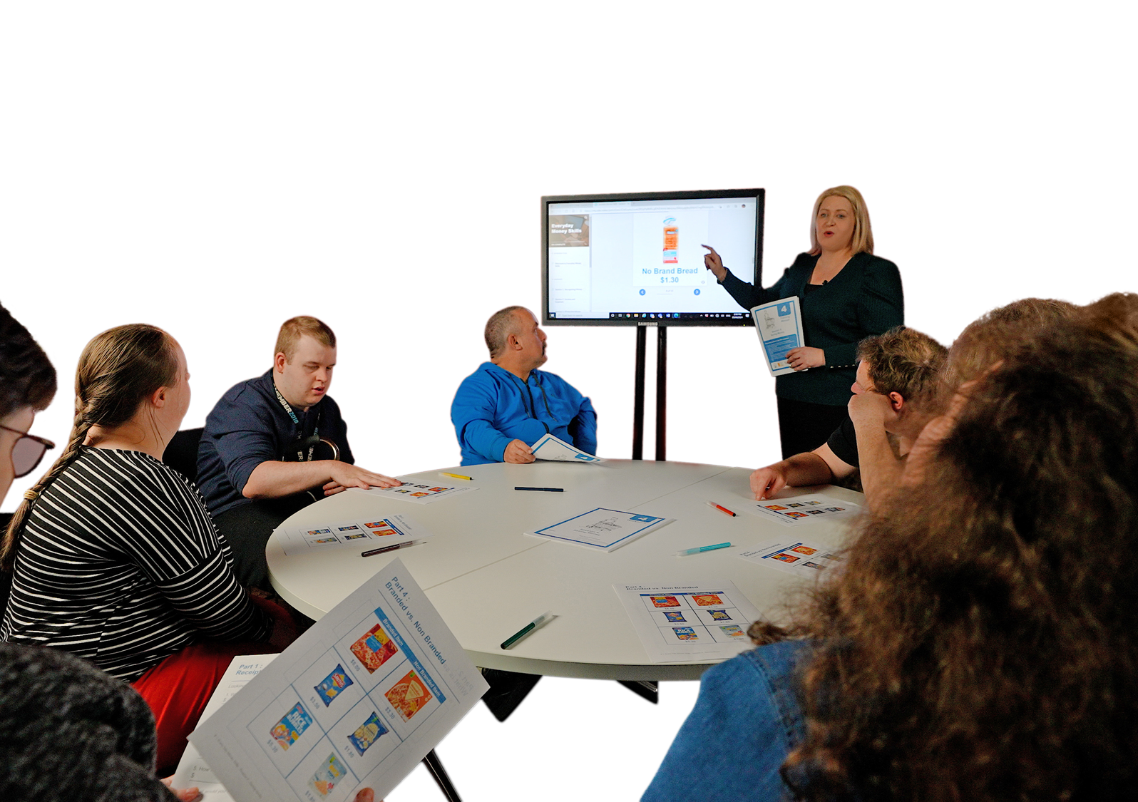
A Family Story
Notes:
To illustrate why this matters, I’d like to share a short story. A family once contacted council looking for guidance. Their son had recently finished school. He had an intellectual disability and had been well supported during his education. But when school ended, the structure that had supported their sondisappeared. Suddenly the family were navigating multiple systems – disability services, employment programs and community activities. All run by different organisations. They described the experience as “falling off a cliff after school. ”What they needed wasn’t necessarily another program. They needed someone to help connect the dots. Understanding: what opportunities existed locally who to talk to and where their son could continue building skills and confidence. And often, that first point of connection is local government.

Slide 5
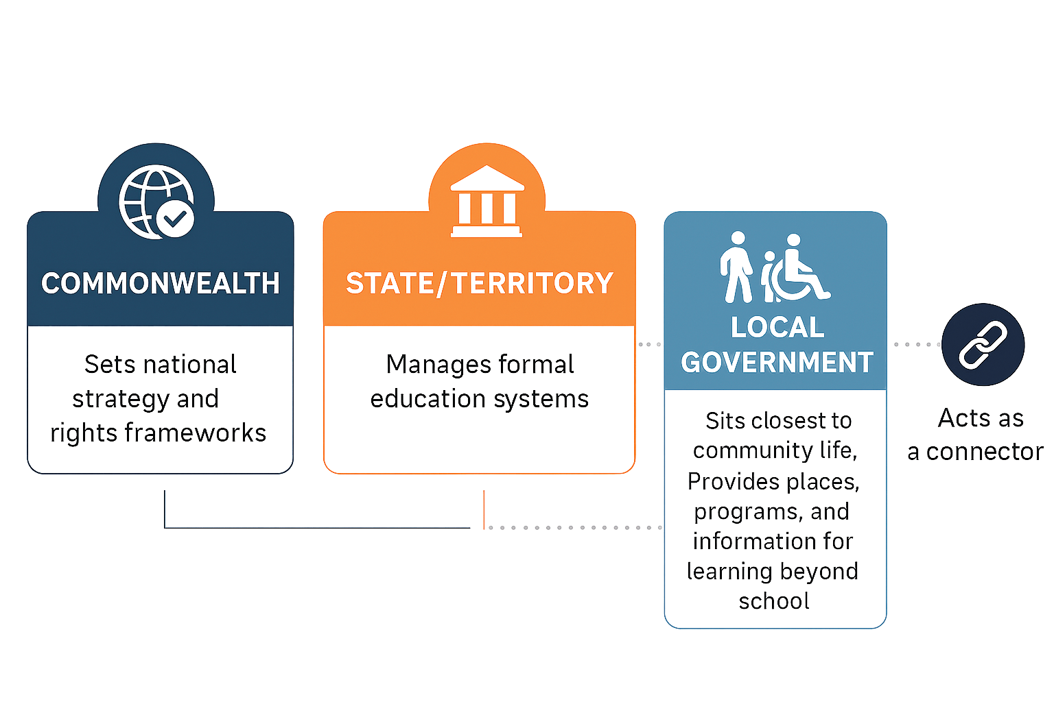
The Ecosystem of Responsibility
Notes:
One way to think about this challenge is as an ecosystem of responsibility.
As we’ve heard earlier today:
The Commonwealth sets national strategy and rights frameworks.
State governments manage formal education systems.
And local government sits closest to community life.
Councils provide the places, programs and information where learning continues beyond school.
From a policy perspective the system makes sense. But from a family perspective, it can feel like navigating a maze.
Which is where local government can play a valuable role as a connector.

Slide 6
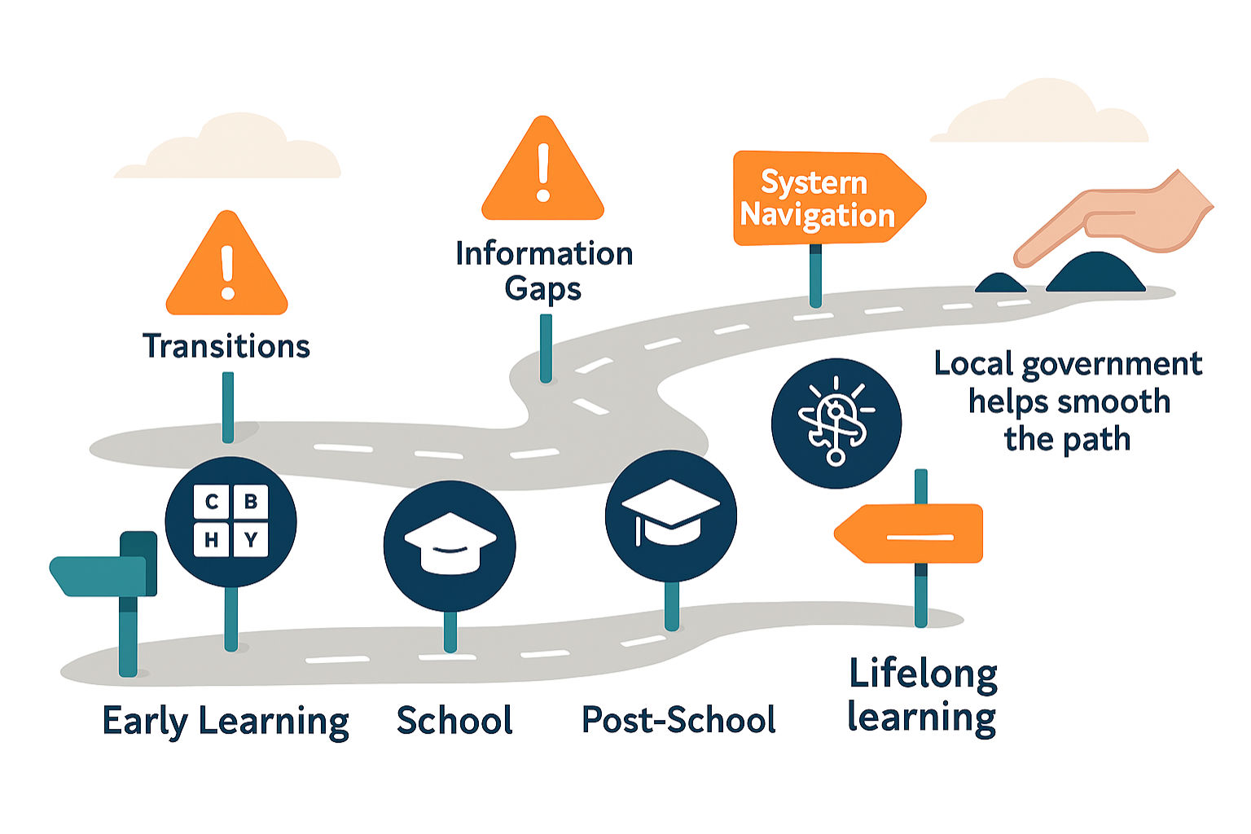
The Learning Journey:
Navigating the Bumps
Notes:
As people move through key stages of learning Early Learning → School → Post‑School Pathways → Lifelong Learning they encounter transition points that can be particularly challenging.
Community attitudes, information gaps, and complex systems can act like barriers or bumps in the road, making it harder to move confidently from one stage to the next.
One of the biggest challenges is the transition from school into adulthood a point where many young people and families feel unsure about what comes next.
This is where local government plays a vital role:
Helping to smooth the pathway, connect residents to supports, and ensure learning and participation continue beyond school.

Slide 7
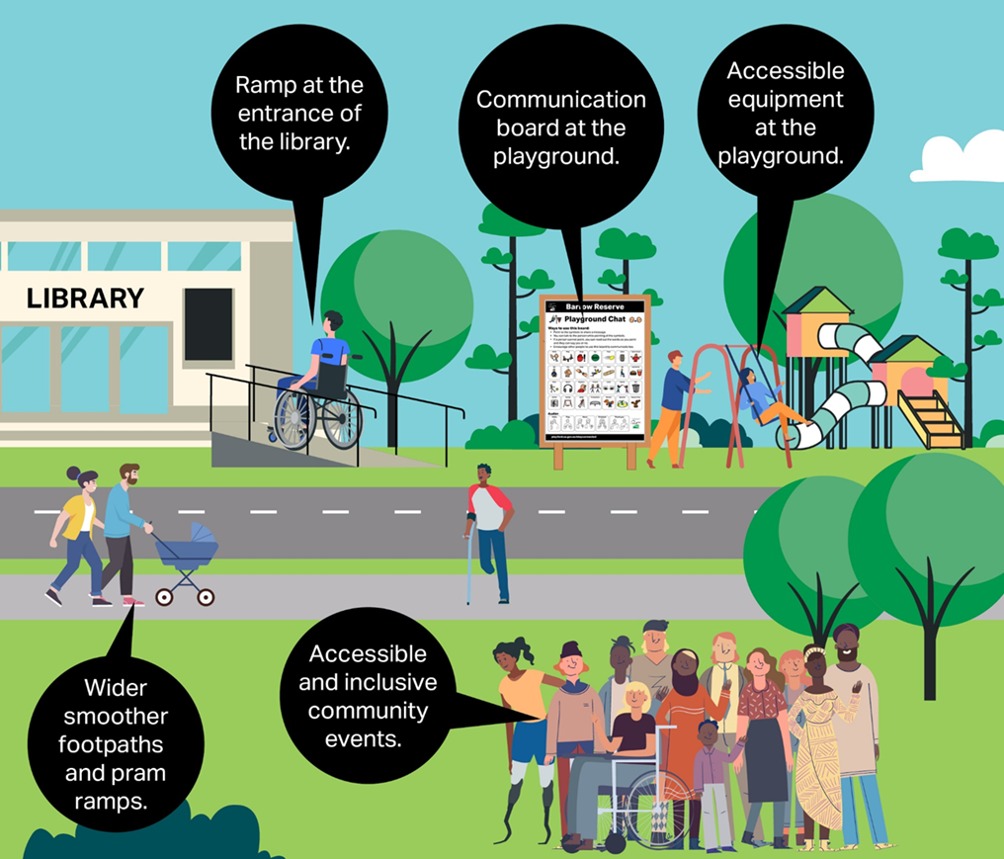
Making a Difference
Libraries
Community programs
Accessible information
Community connections
Notes:
Local government plays a unique role because it sits closest to everyday community life.
Councils provide:
libraries and community hubs
local programs that build life skills
accessible information
and connections to services and opportunities.
For many residents, council is simply the most visible and accessible level of government.
Sometimes the most valuable role a council plays is helping people navigate what already exists.

Slide 8
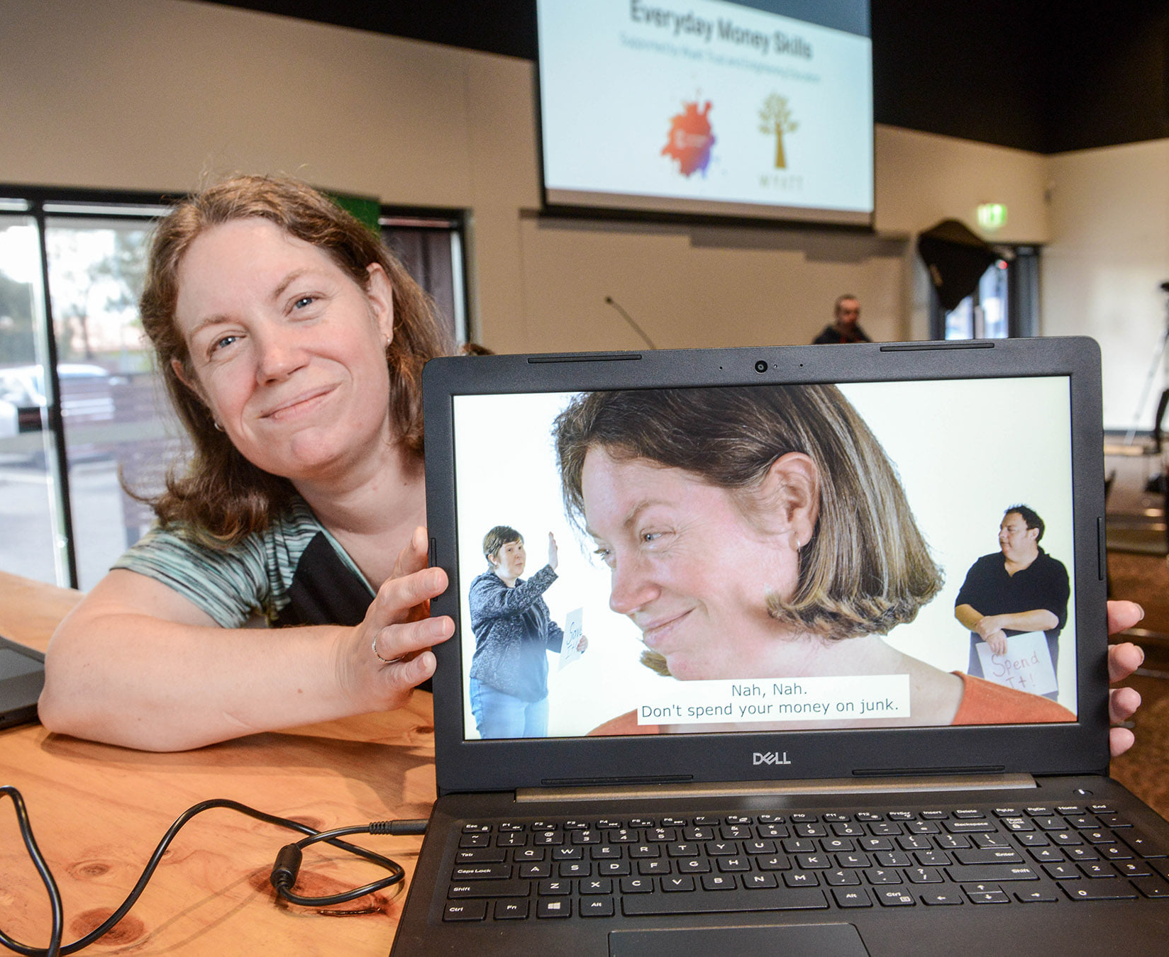
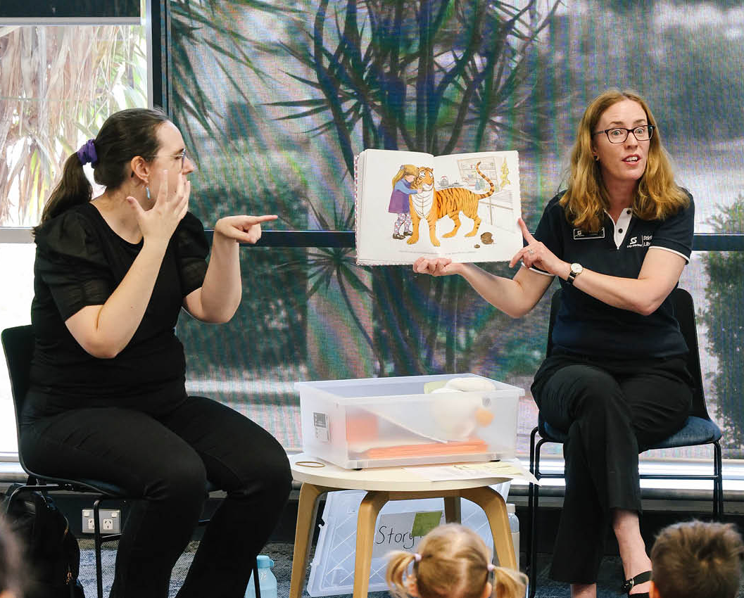

What Inclusive Learning Looks Like in Practice
Everyday Money Skills
Auslan Storytime
Look ’n Cook
These are not specialist programs; they are inclusive versions of everyday community activities.
Notes:
There are many practical ways councils already support inclusive learning.
At the City of Playford, Life Skills programs such as Everyday Money Skills support people with intellectual disability to build financial literacy and independence. This is a free online learning platform covering relevant topics such as : Recognising money, Income and expenses, Protecting money, Saving money, Borrowing, Budgeting. Everyday Money Skills was co‑designed with people with disability, built from a pilot created in collaboration and part‑funded by an external grant. Councils can use this free program from the City of Playford website (search Everyday Money Skills), with downloadable trainer and learner guides, and run it as small group sessions in libraries or community centres, or as 1:1 support.
Playford’ Look ’n Cook is a cookbook and short videos with visual step‑by‑step recipes, co designed with people with disability. Utilising visual instructions to help people develop cooking skills and confidence in the kitchen.
City of Stirling in Western Australia are running Inclusive literacy programs such as Auslan Storytime in partnership with Deaf Connect, where children learn literacy while also learning inclusive communication. What these examples show is that inclusive learning initiatives are often simple adaptations of existing programs. Not massive new services. Sometimes it’s about designing programs so everyone can participate.
Facilities + programs + information, when all three move together, participation lifts. DAIPs help us plan, resource and report that movement.
Most inclusive learning initiatives are not new services — they are inclusive versions of programs councils already run.

Slide 9
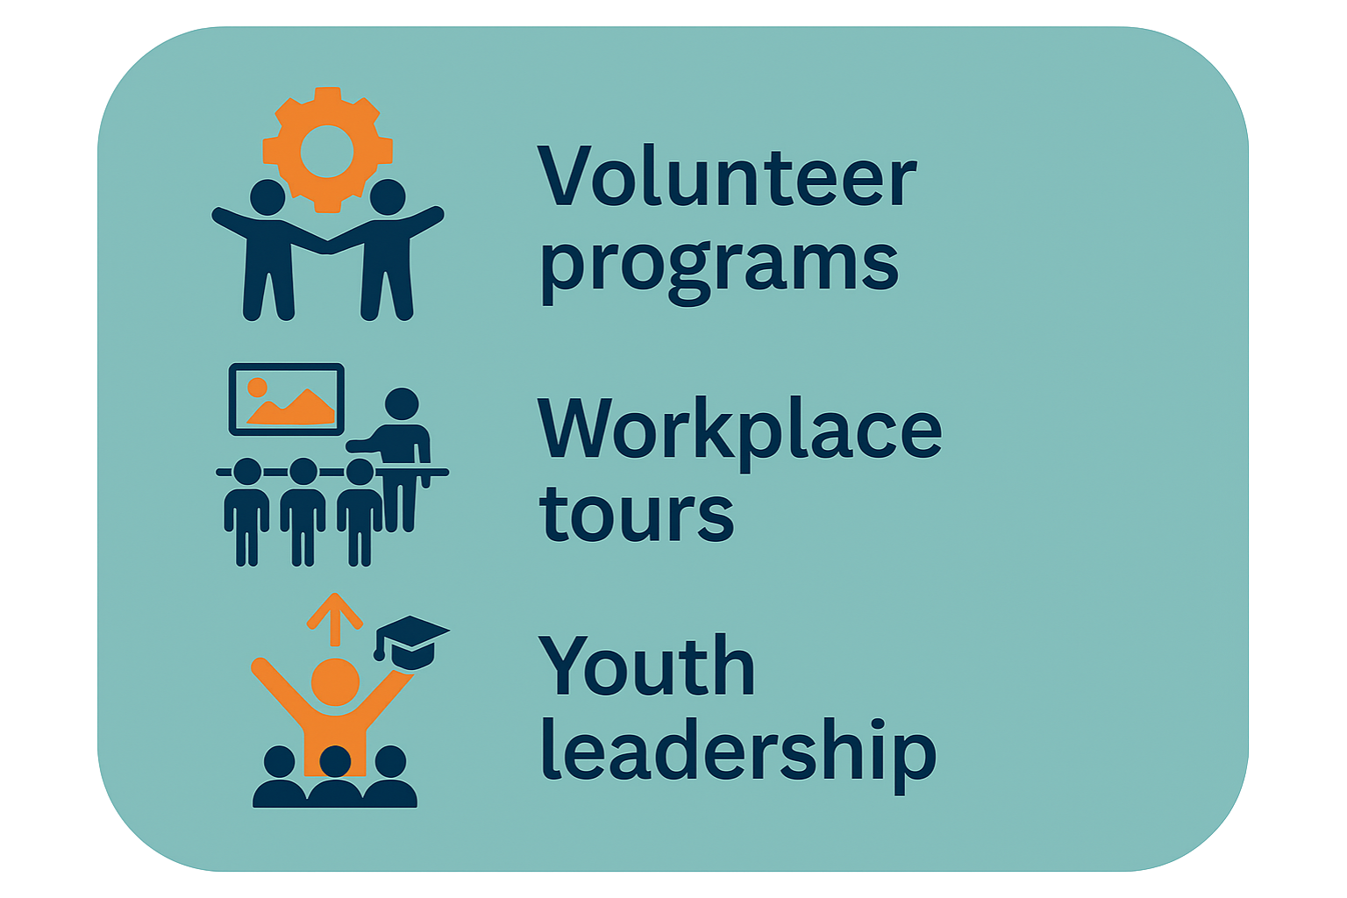
Supporting transition from school
Notes:
One area where councils can make a particularly meaningful contribution is supporting young people transitioning from school into adulthood. For many young people with disability, the end of school is one of the biggest cliff edges in the disability support system.
Councils can help bridge this gap through:
Workplace/Industry tours of council services
volunteer opportunities in libraries and events
youth leadership
community programs.
These experiences build confidence, work readiness and community connections. And sometimes they open doors to employment pathways that people might never have considered.

Slide 10
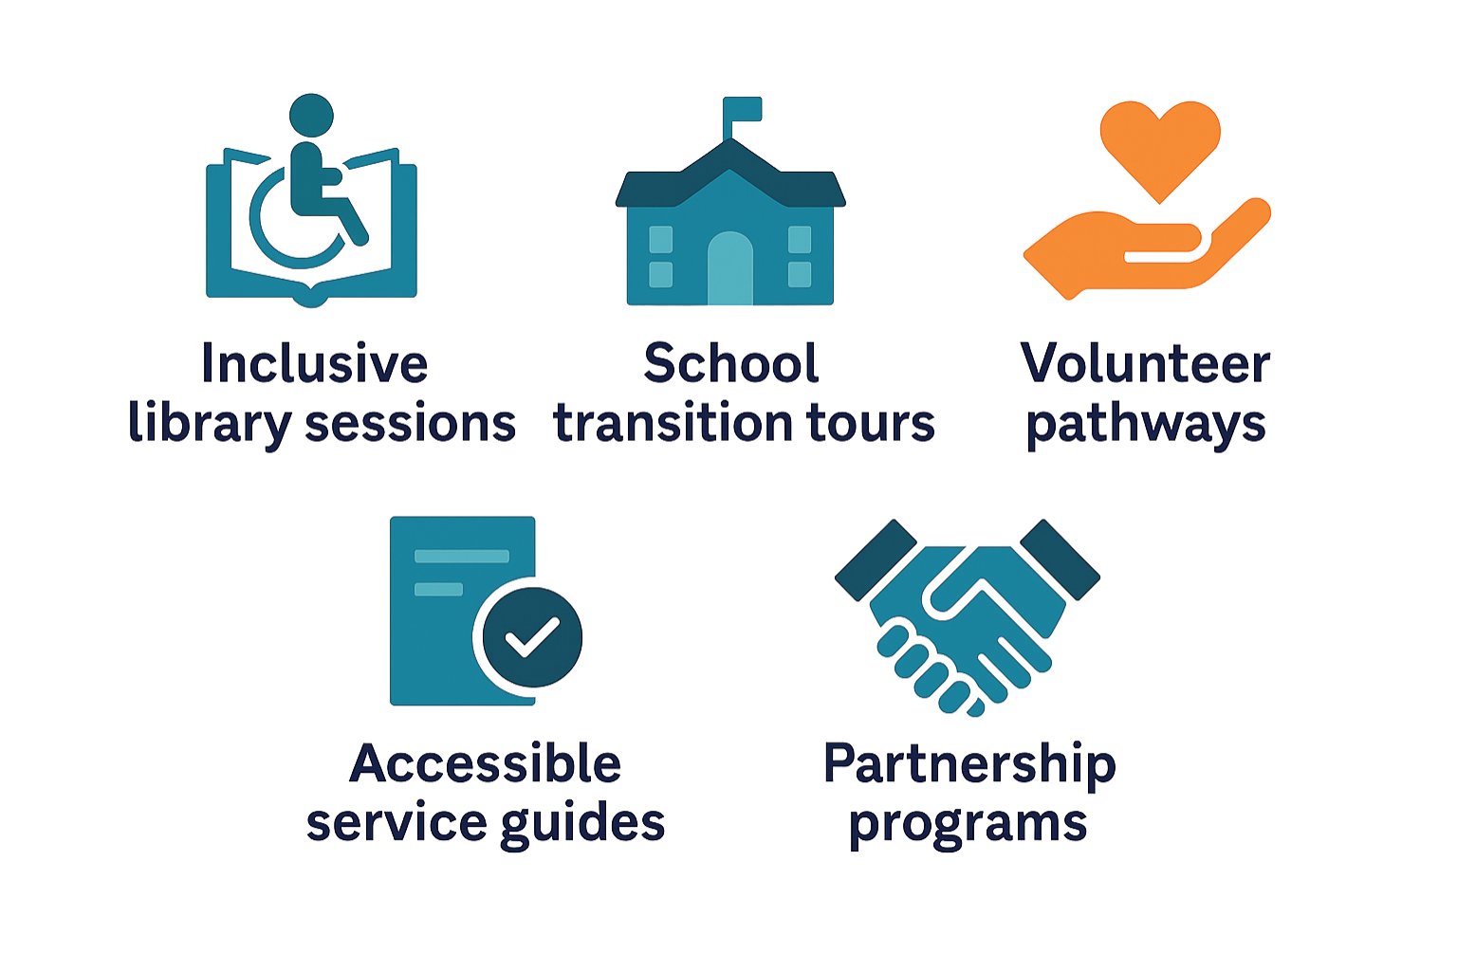
Five simple actions councils can take
Notes:
A simple starting point for many councils is asking one question:
“How accessible and inclusive are the learning opportunities we already offer?”
Councils don’t have to run the education system — but we can open the doors where learning continues. Sometimes that door is a library program, a youth leadership opportunity, a volunteer role, or simply making information accessible.
For councils looking to strengthen inclusive learning opportunities, there are several practical steps that can make a difference.
• review library programs
• review youth programs
• check accessibility of information
• create inclusive volunteer pathways
None of these require councils to become education providers they simply require inclusive design and strong partnerships.
Often the most valuable thing councils can do is simply connect people with opportunities that already exist.

Slide 11
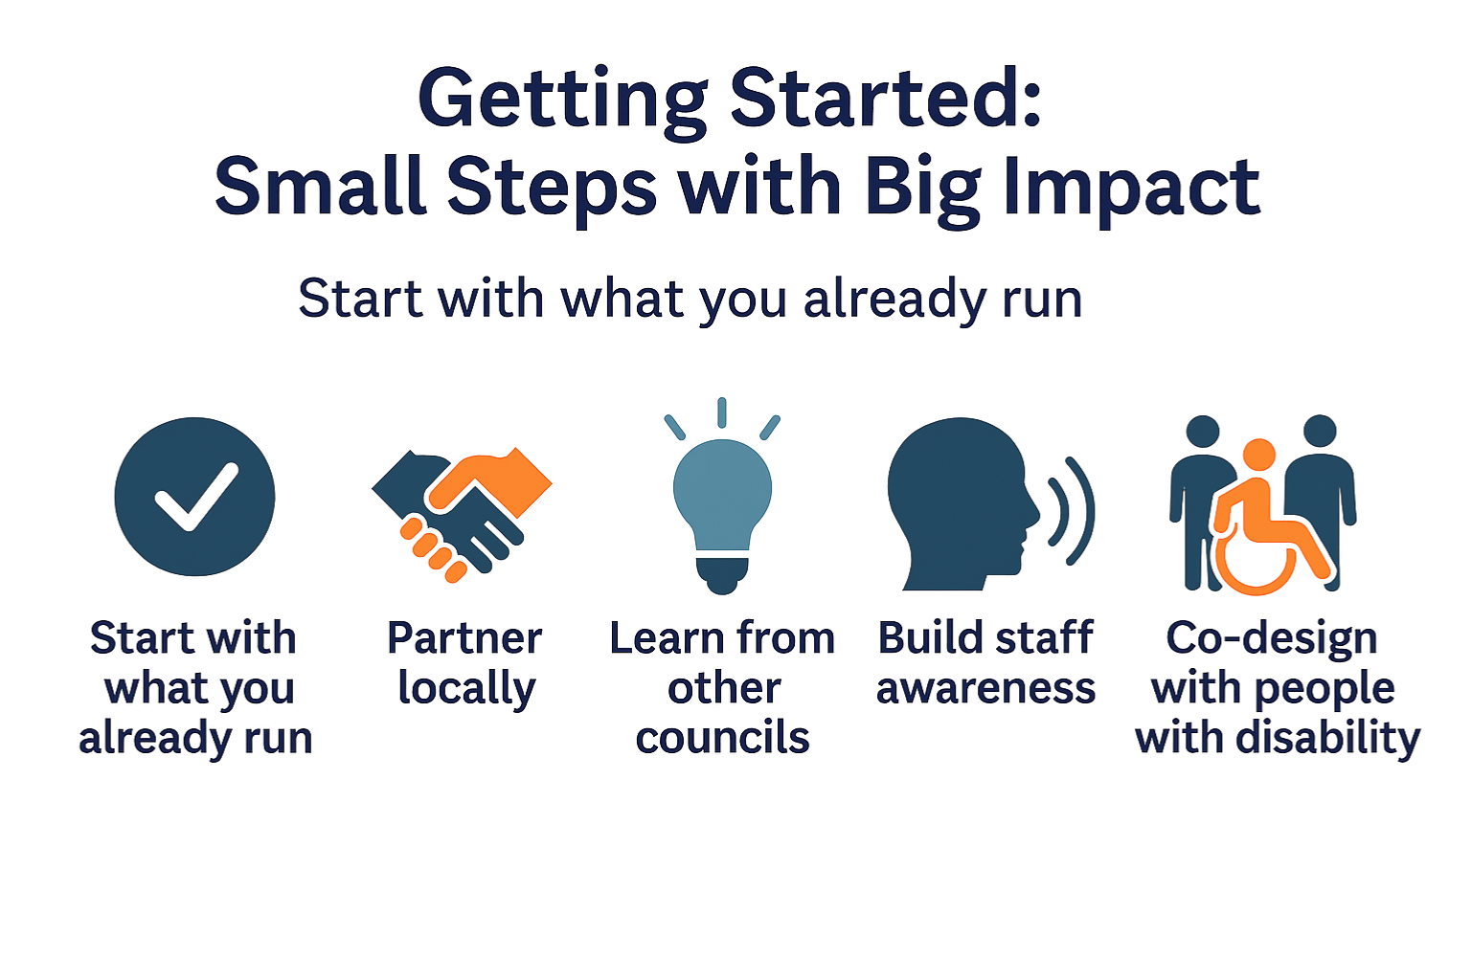
Notes:
Many councils are already doing parts of this work, sometimes they just haven’t labelled it as inclusive learning.
The easiest place to start is by looking at existing programs.
Libraries, youth programs, volunteer programs and community events are all opportunities to build inclusion.
Partnerships are also incredibly powerful.
Councils don’t need to do everything alone working with schools, disability organisations, and local community groups can help create programs that really work.
Another great step is connecting with other councils who are already doing this work.
Local government networks are full of practical examples that can be adapted locally.
And finally, the most important step, involve people with disability in designing programs and services.
Inclusion works best when it’s shaped by lived experience.

Slide 12
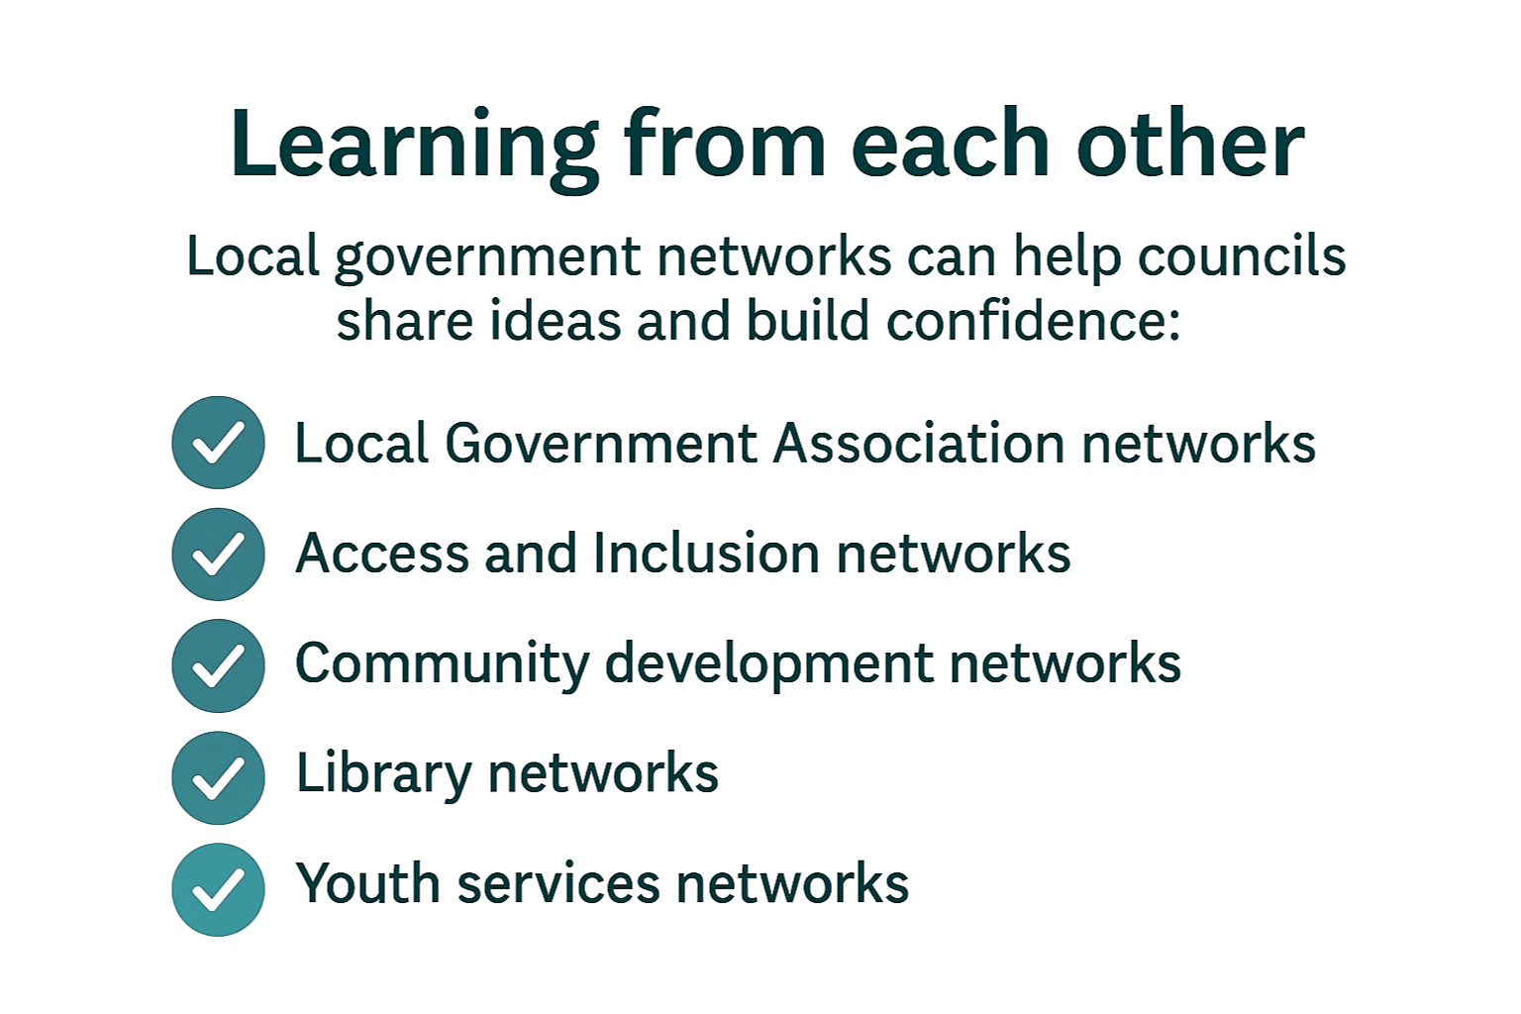
Notes:
One of the strengths of local government is the ability to learn from each other.
Councils across Australia are trialling great ideas, from inclusive library programs to supported volunteering and youth leadership initiatives.
Sharing those ideas through networks allows councils to adapt and scale what works.
Such as:
Local Government Access and Inclusion Networks
LGA networks
ALGA Communities of Practice

Slide 13
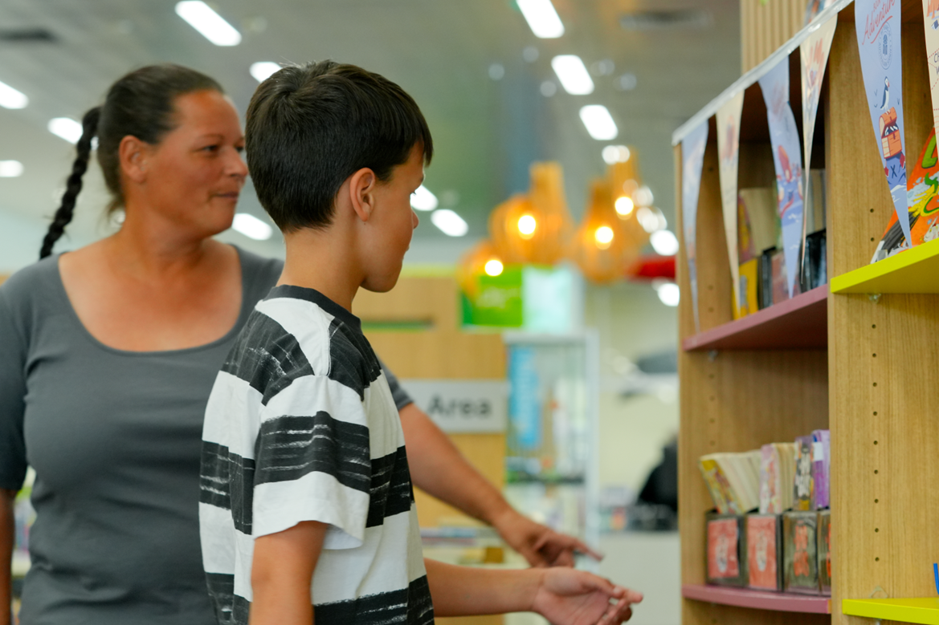
Local government connects people with opportunity
Notes:
Local government may not hold responsibility of the education system, but we shape the communities where learning continues.
But councils help create the environments where learning continues throughout life.
Through inclusive spaces, community programs and strong partnerships, local government helps ensure people with disability can continue learning, participating and contributing to their communities.
And sometimes the most powerful thing a council can do…
is simply open a door to opportunity.
Thank you, and I look forward to the discussion.

Slide 14
Resources and Further Information
Inclusive Learning and Local Government Resources
Department of Social Services – National Disability Strategy
https://www.disabilitygateway.gov.au
Australian Government Department of Education – Inclusive Education
https://www.education.gov.au/inclusive-education
Australian Human Rights Commission – Disability Standards for Education
https://humanrights.gov.au
NDIS Quality and Safeguards Commission – Community and Capacity Building Resources
https://www.ndis.gov.au
Australian Local Government Association (ALGA)
https://alga.com.au
Public Libraries SA
https://www.plsa.org.au
Notes:
We’ll share these resources after the webinar as well. They include national strategies, local government networks and examples of inclusive community programs.

