Slide 1

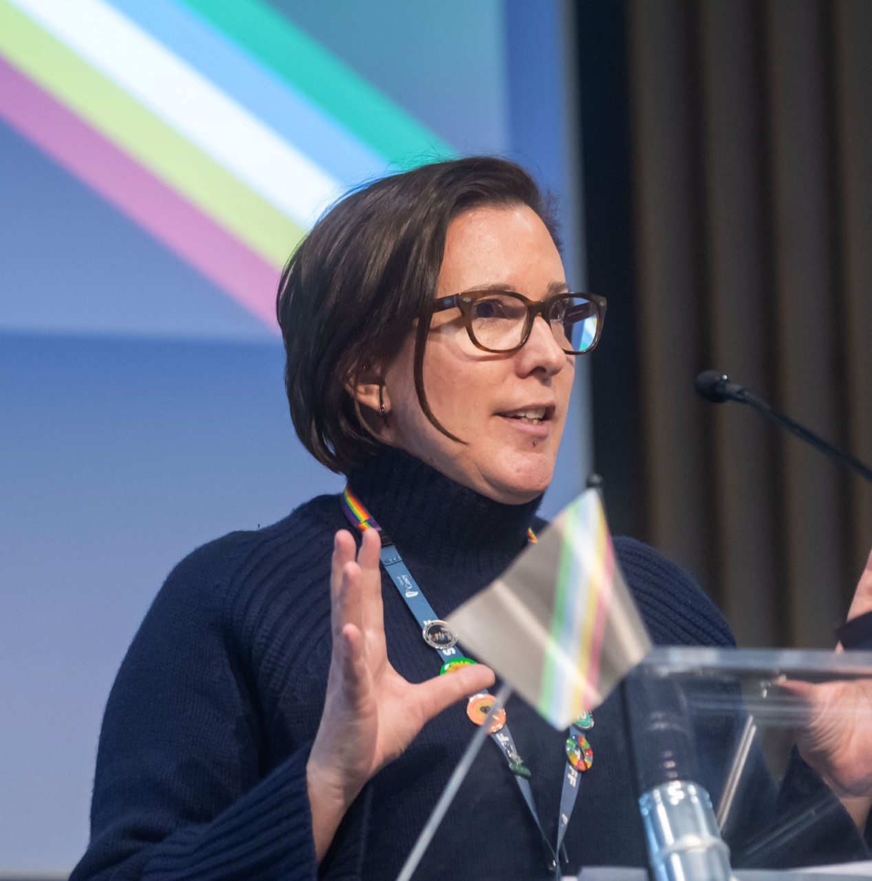
Disability Inclusion: Employment, Education and Community Attitudes
24 March 2026
Alexandra Bignell
City of Casey

Slide 2
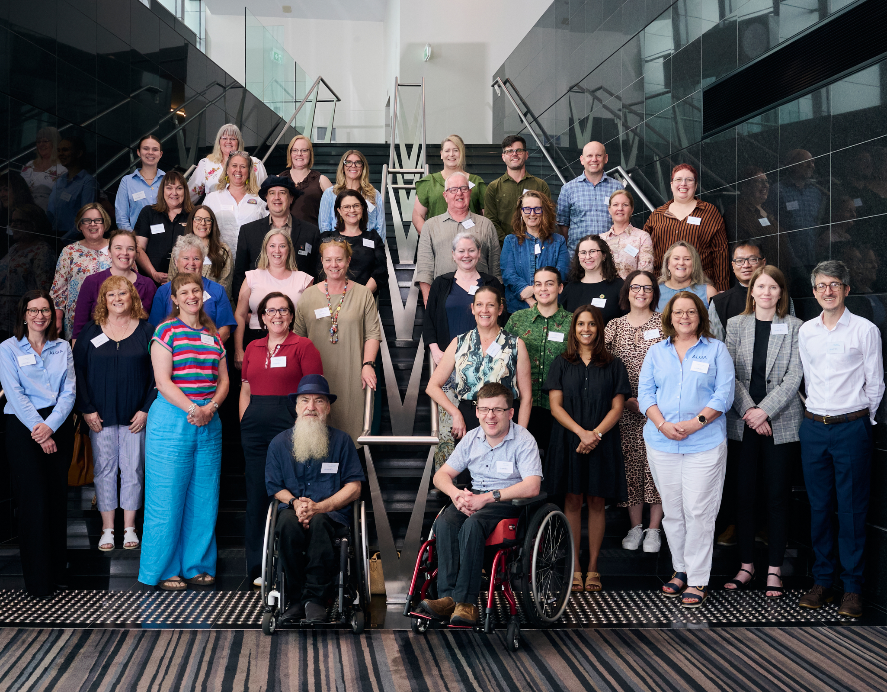
Disability Inclusion Community of Practice
Members
The Community of Practice includes council officers from across Australia who are working in disability inclusion, access, community development, planning, and related areas. Membership includes councils from metropolitan, regional and remote communities, reflecting the diversity of local government across the country.
Purpose
The purpose of the Community of Practice is to strengthen disability inclusion across local government by creating a national space where councils can share knowledge, learn from each other, and work collectively on improving inclusive practice.

Slide 3
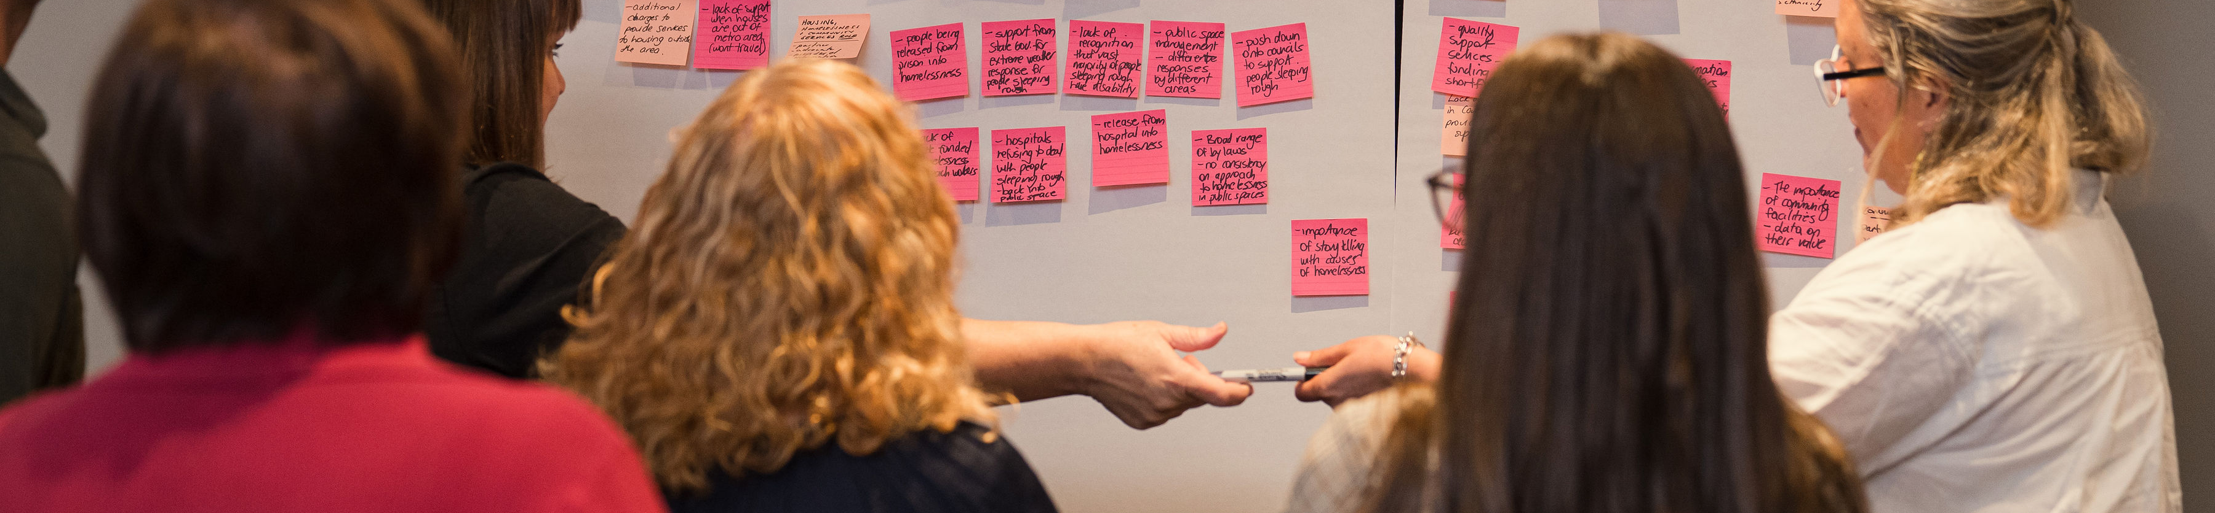
Key initiatives
Disability Inclusion guide for local Government
Series of webinars and workshops
Working groups aligned to Australia’s Disability Strategy
National showcase of council-led initiatives

